Slide 1
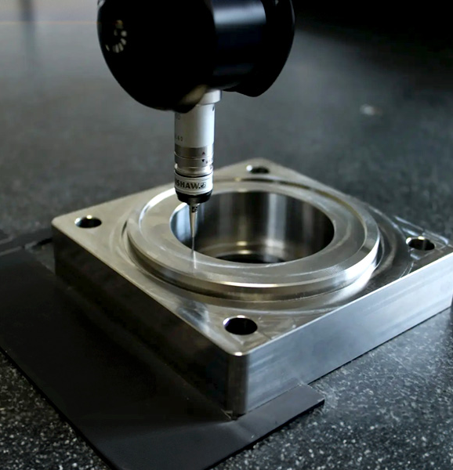
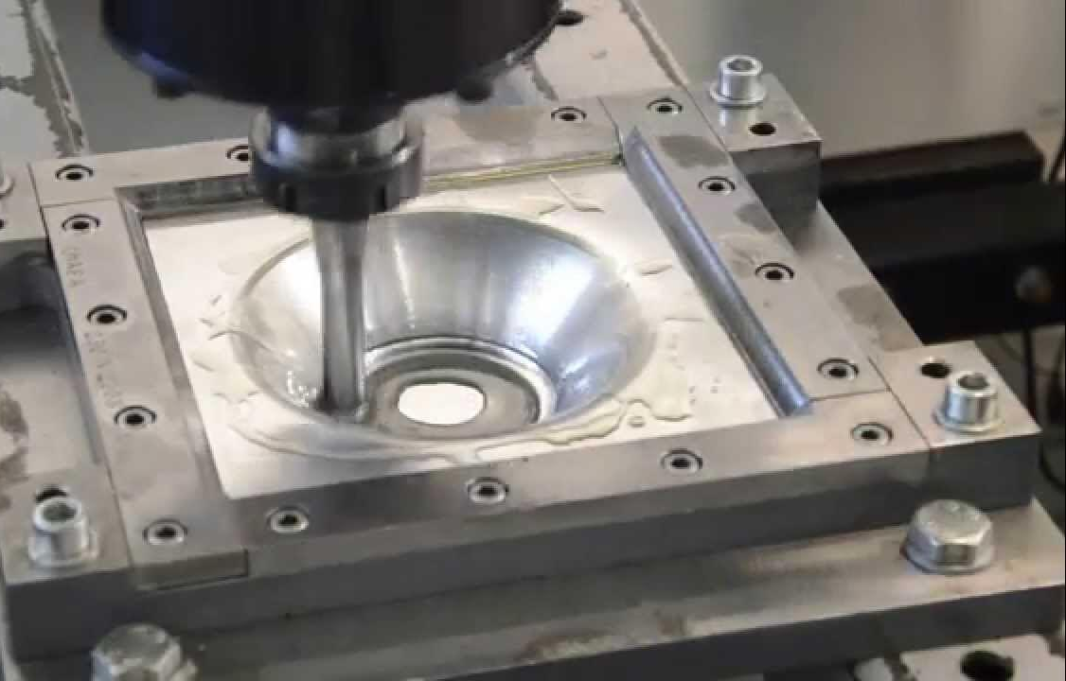
SINGLE POINT INCREMENTAL FORMING (Miniproject)
Presented By :-
Mahendra Sarnaik (612213075)
Tanish Shastare (612213076)
Onkar Shete(612213077)
Suraj Sonune(612213078)
Summit Tabhane(612213079)
Shruti Mahajan(112113037)
Under guidance of:-
-Aishwarya Dange Ma’am

Slide 2
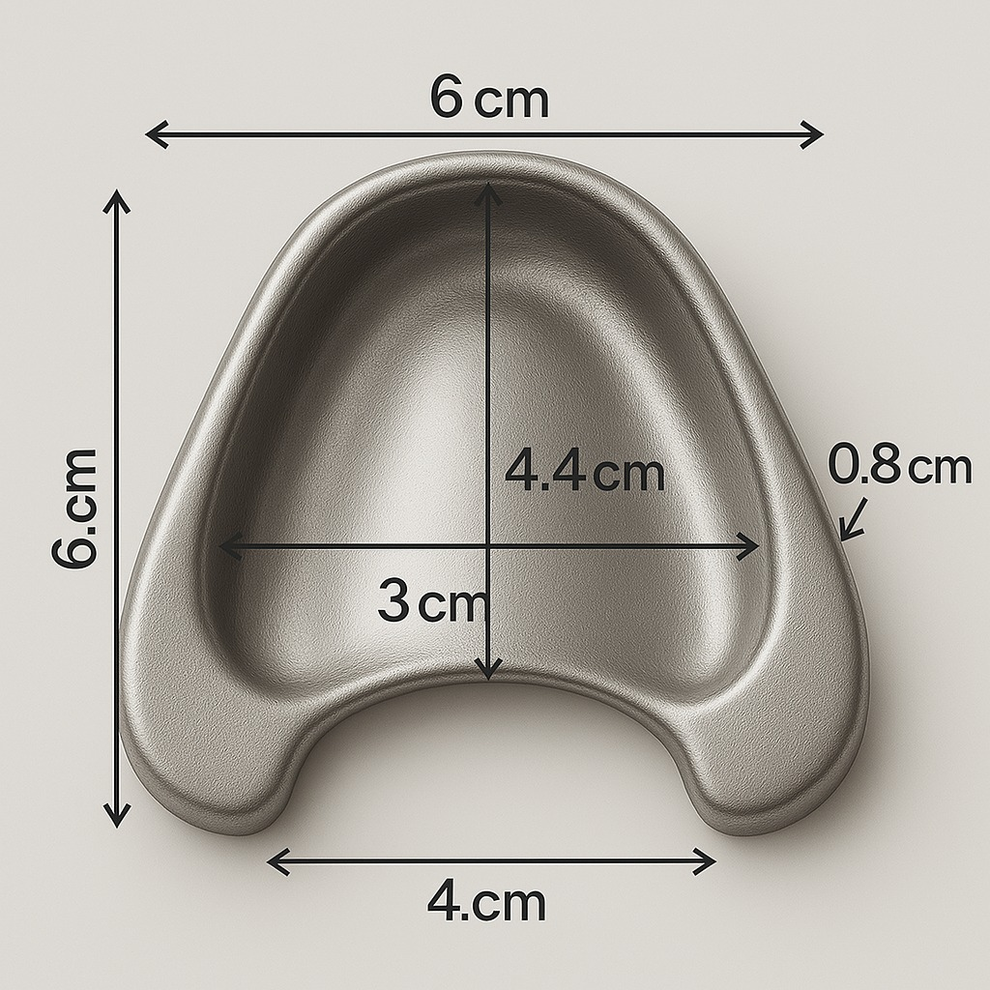
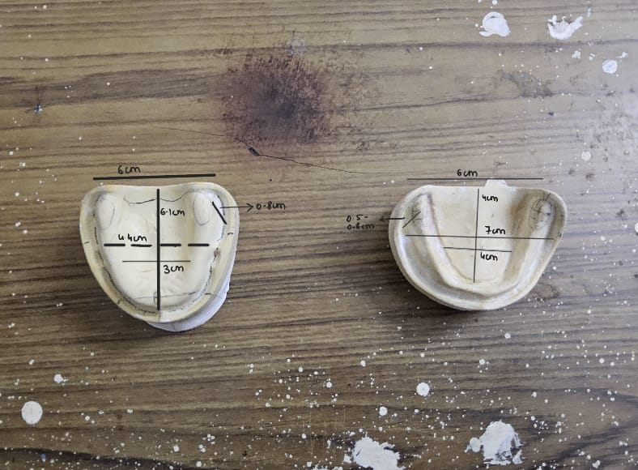
OBJECTIVE
To analyze and validate the Single Point Incremental Forming (SPIF) process parameters by initially manufacturing a frustum-shaped geometry using aluminum sheet, as a preparatory step towards the final objective of fabricating a denture plate through SPIF.
A denture plate is a custom-made base that supports artificial teeth, fitting over gums to restore oral function and aesthetics.

Slide 3
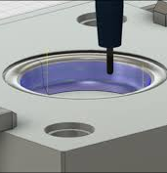
WHAT IS SPIF?
Single Point Incremental Forming is an advanced sheet metal forming technique where a CNC-controlled tool moves along a predefined path to incrementally deform the metal sheet into a desired shape. Unlike conventional stamping or deep drawing, SPIF does not require expensive dies, making it highly flexible and cost-effective for prototyping and low-volume production.
Working Principle of SPIF:
Setup: A flat sheet metal is firmly clamped in a fixture, usually on a CNC milling machine or a robot-assisted setup.
Tool Motion: A single hemispherical forming tool moves in a controlled manner along the sheet, following a programmed toolpath.
Incremental Deformation: The tool presses against the sheet metal in small steps, gradually shaping it into the required geometry.
Support Mechanisms: SPIF can be performed with or without a backing/support die. In "die-less" SPIF, the sheet is only supported by the clamping fixture.

Slide 4
APPLICATIONS
AEROSPACE
Wing skin ,fairings , drone bodies
AUTOMOTIVE
Prototypes , custom racing panels
MEDICAL
Patient specific implants like Denture plate
DEFENSE
UAV panels , military casing
INDUSTRIAL
Prototyping dies , custom covers

Slide 5
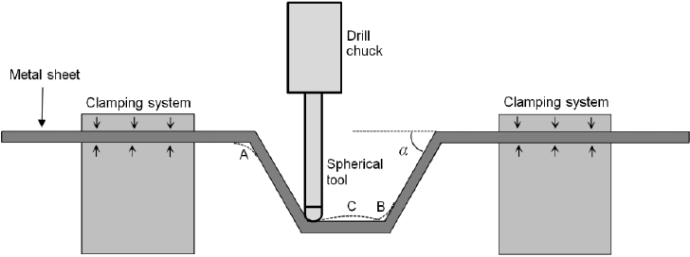
WHAT WE ARE PERFORMING?
We are utilizing the Vertical Machining Center (VMC) available in our department to carry out Single Point Incremental Forming (SPIF). Our project involves designing and manufacturing a specialized fixture capable of securely holding the workpiece during the operation. Additionally, we will develop a forming tool designed to perform precise incremental shaping of the material. This setup will enable us to execute the SPIF process efficiently, ensuring accuracy and consistency in the formed components.
This

Slide 6
PROJECT ROADMAP
DESIGNING :Of the fixture & tool
SIMULATING : The forming process
PROTOTYPING: The setup of the process
TESTING: Precision & accuracy

Slide 7

MATERIAL
WORKPIECE : Aluminium sheet (Al 6061)
TOOL: HSS(High speed steel)
FIXTURE: Mild Steel (MS)

Slide 8
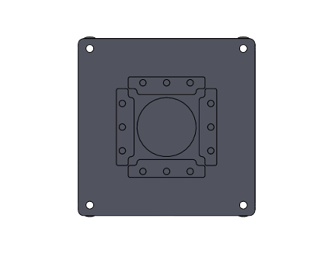
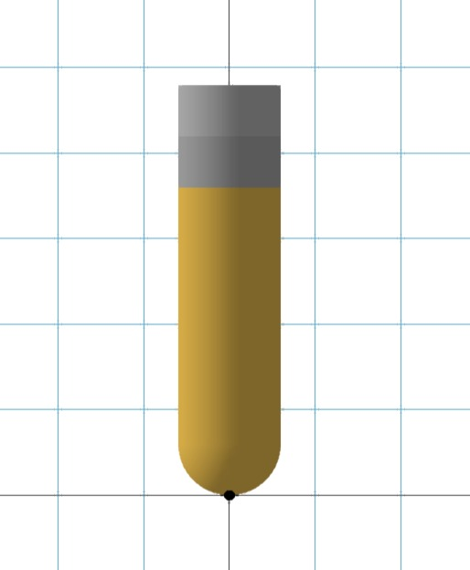
DIMENSIONS
DIMENSIONS OF FIXTURE :
Dimensions of Base Plate & Top Plate = 300mm*300mm*10mm
Dimensions of Clamping Plate = 124mm*30mm*10mm
Length of Spacer=100mm
Radius of Spacer = 40mm
Dimensions of clamping plate = 124mm
Diameter of hole of clamping plate =11mm
DIMENSIONS OF TOOL
Shank Length=88mm
Diameter =10mm
Collect length =34mm

Slide 9
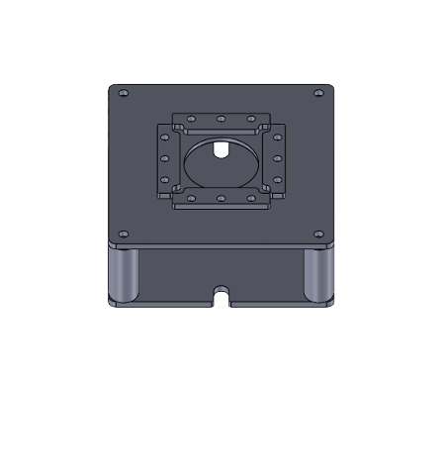
DESIGN
The fixture was designed to ensure precise and secure mounting on the machine bed. The design and manufacturing process followed a structured approach .
Measurement and Initial Design: The dimensions of the machine bed were carefully measured to determine the mounting constraints and ensure proper alignment of the fixture.
3D Modeling and Design Validation: A detailed 3D model of the fixture was created using SolidWorks to visualize its structure, assess fitment, and identify potential design improvements.
Similarly , the single point tool was designed using SolidWorks .

Slide 10
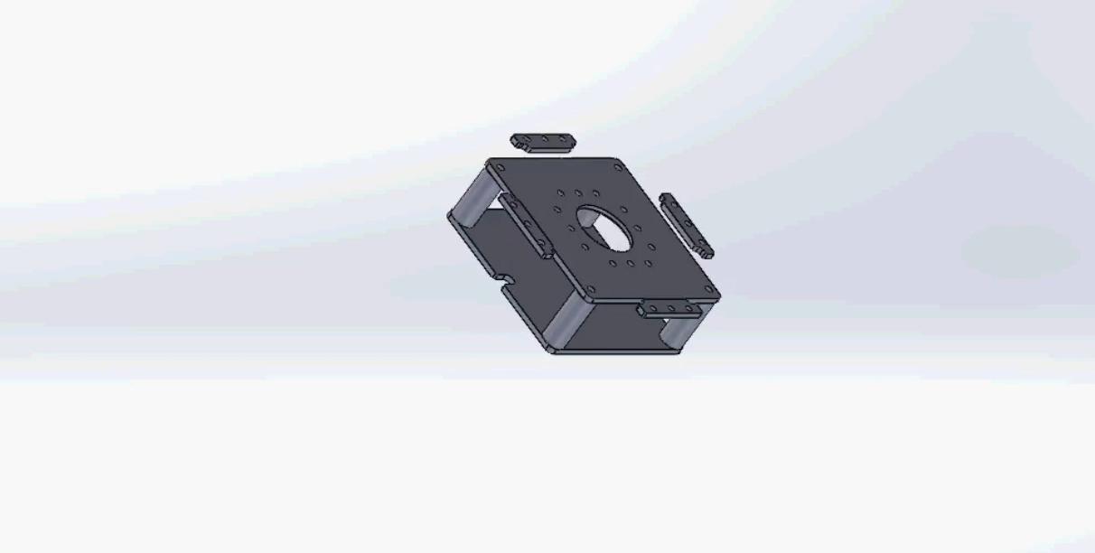
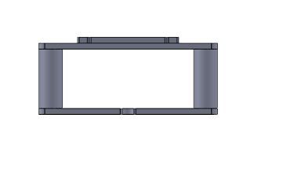
FIXTURE DESIGN
Visual representation of fixture along with burst view of fixture which showcases all the component in the fixture.

Slide 11
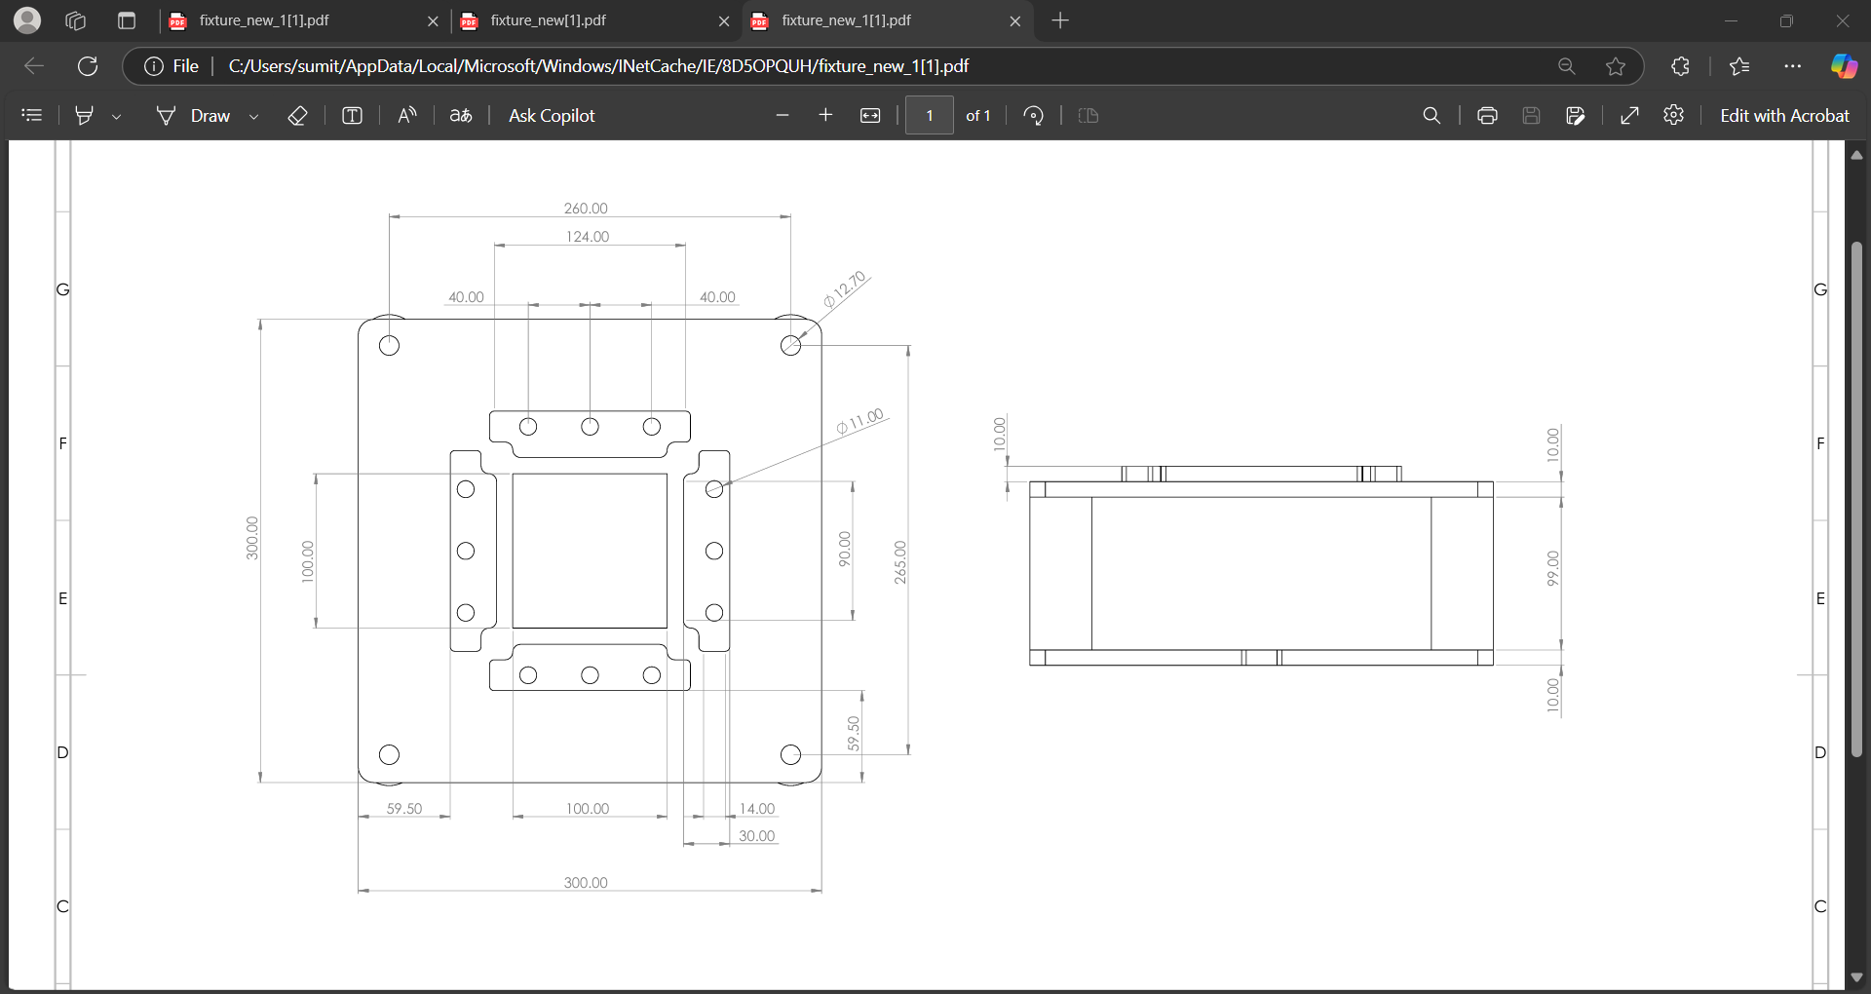
FIXTURE
ALL DIMENSIONS IN MM

Slide 12
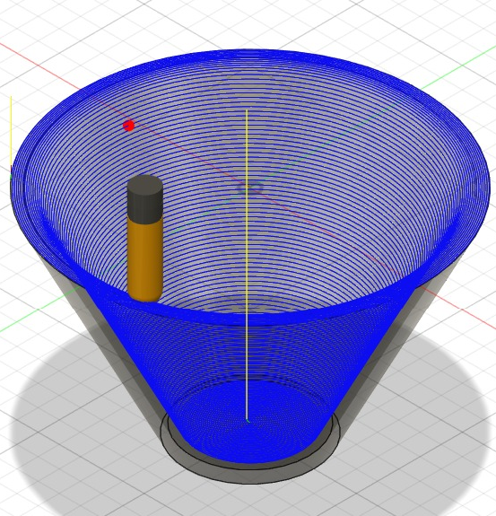
SIMULATION
Model Creation in Fusion 360
Designed a 3D frustum model in Fusion 360 for SPIF.
Considered the physical properties of the aluminum sheet for optimal forming.
Toolpath Generation
Adjusted feed rate and depth of cut for smooth and accurate machining.
Ensured proper tool engagement with the workpiece.
Simulation and Optimization
Ran a complete simulation to check for tool collisions and accuracy.
Fine-tuned step depth and feed rate to improve surface quality.
Post-Processing and G-Code Generation
Used the Post Process tool in Fusion 360.
Selected the appropriate CNC machine and generated the G-code for execution.

Slide 13
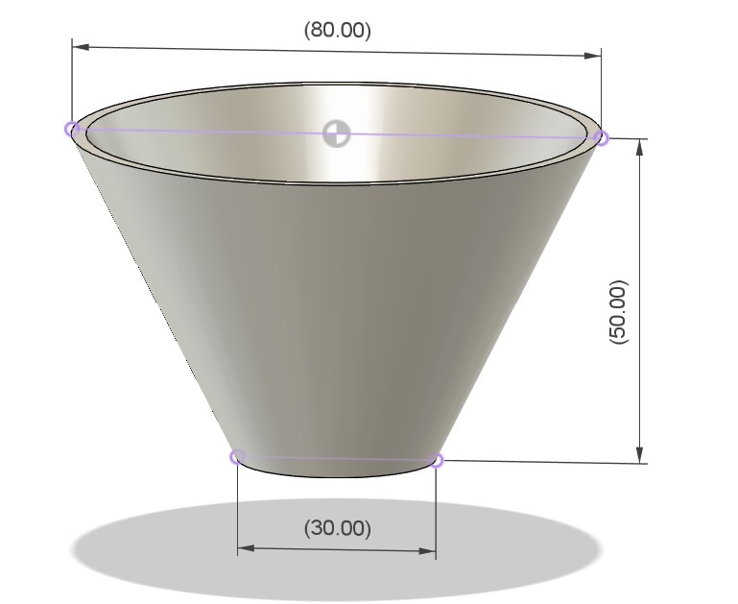
WORKPIECE DIMENSIONS OF FRUSTUM: Outer diameter = 80mm Inner diameter = 30mm Depth = 50mm Process Parameters: Spindle speed (rpm)=300 Vertical step depth (mm)=1.0 Feed rate (mm/min)=300 Tool diameter (mm)=10 Sheet thickness (mm)=3.0

Slide 14
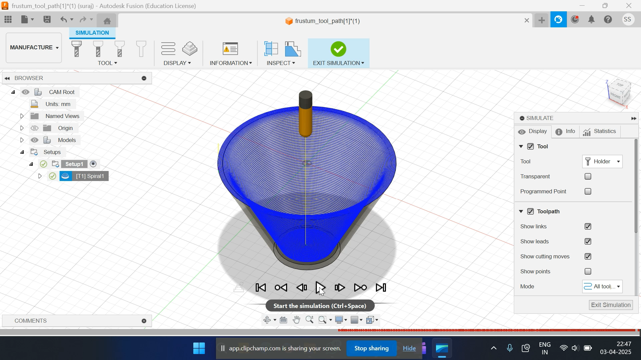
SIMULATION

Slide 15
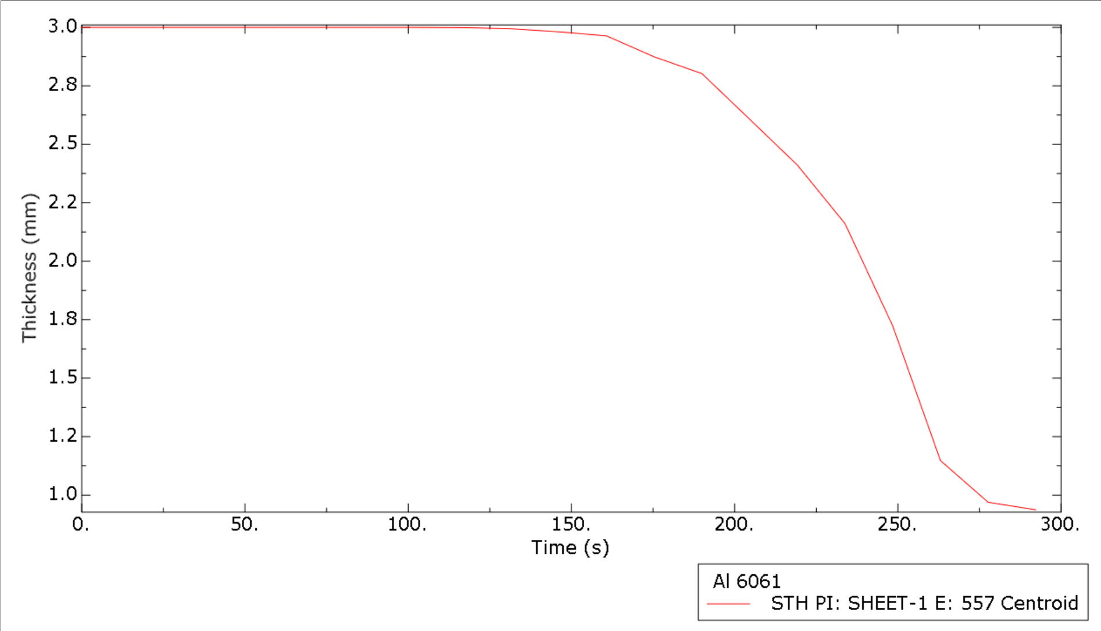
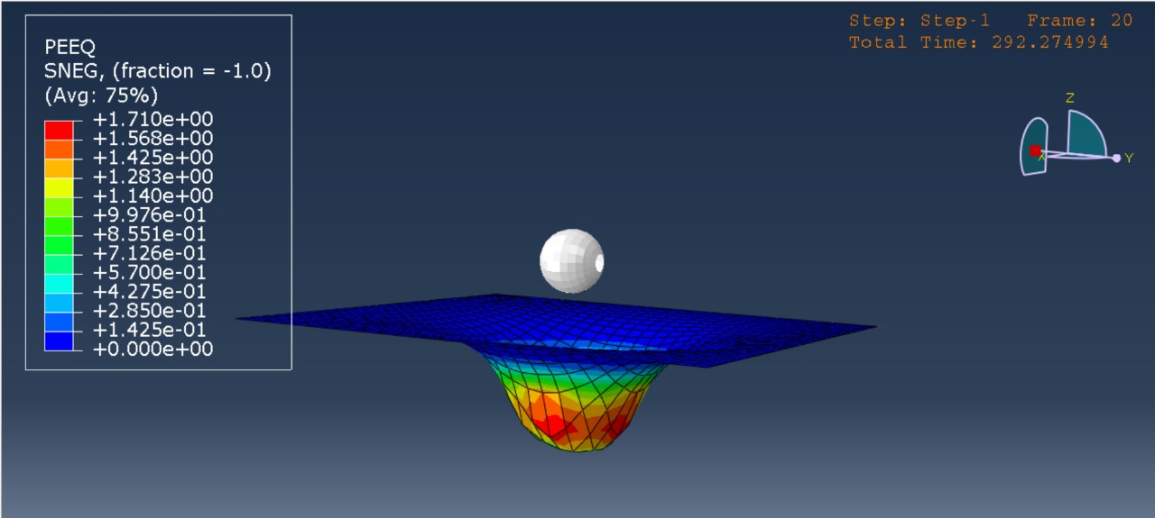
ANALYSIS
Define Geometry and Material Properties
Create the sheet metal workpiece and the forming tool (hemispherical or conical punch).
Assign Al 6061-T6 material properties by defining mechanical characteristics in the Property Module.
Setup Contact, Interactions, and Boundary Conditions
Establish surface-to-surface contact with appropriate frictional properties.
Fix sheet metal edges and apply tool motion to simulate the forming process.
Mesh and Analysis Configuration
Generate a fine mesh on the sheet metal for precise results.
Set up an explicit dynamic step to handle the high-strain-rate nature of SPIF.
Define Output Requests and Submit Job
Request outputs for contact reaction forces, sheet thickness variation, tool contact pressure, Von Mises stress, and equivalent plastic strain.
Submit the job in the Job Module and ensure error-free execution.
Post-Processing and Result Analysis
Visualize thickness reduction and analyze force variations (CF1, CF2, CF3, CFM) in the Visualization Module.

Slide 16
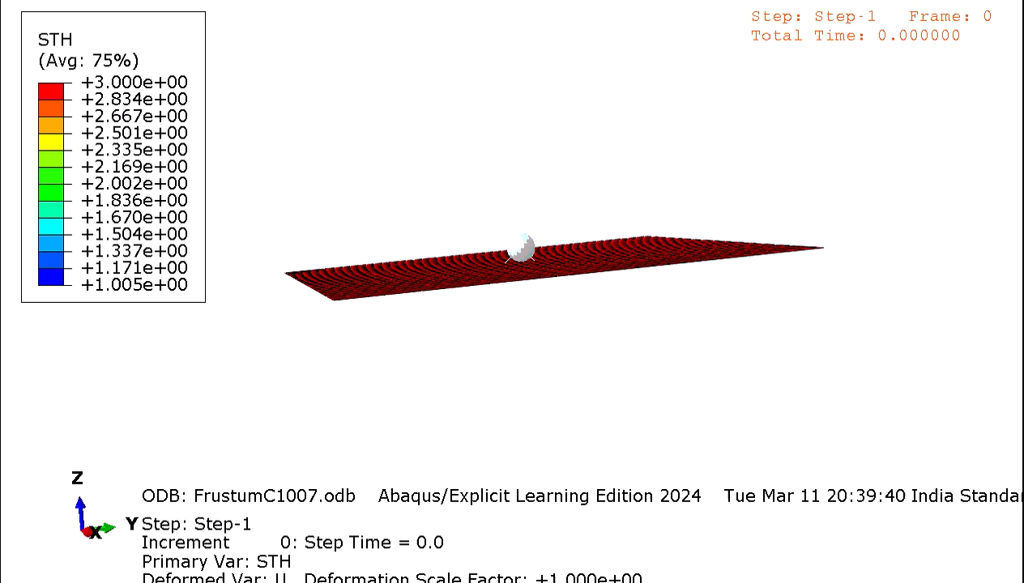
SHEET DEFORMATION

Slide 17
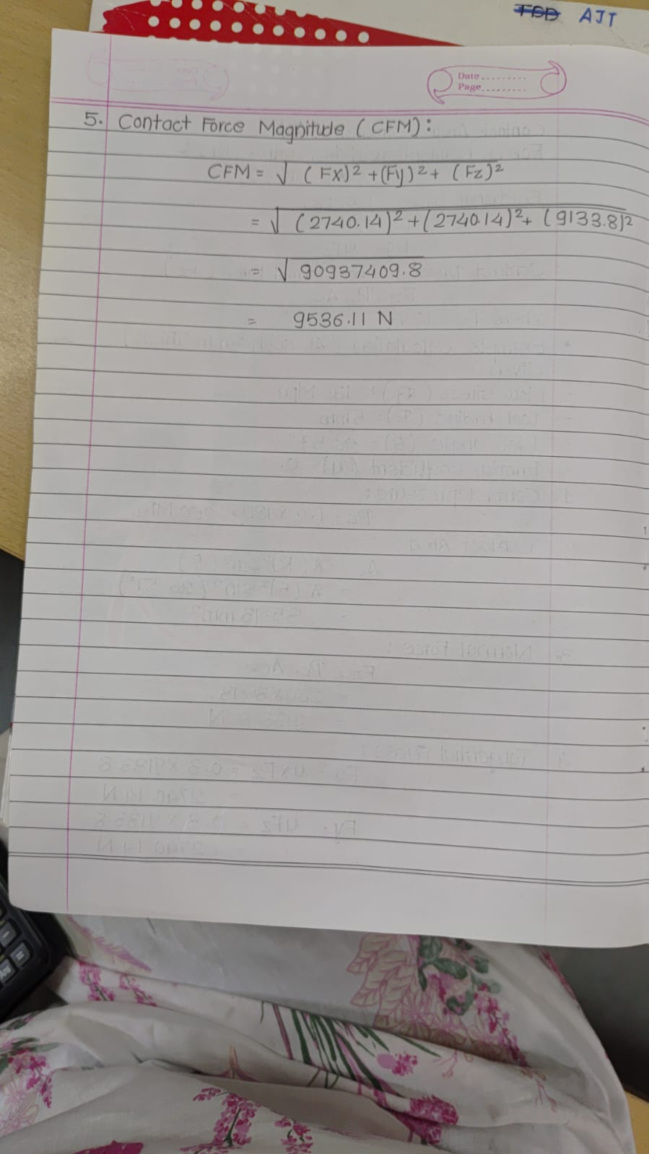
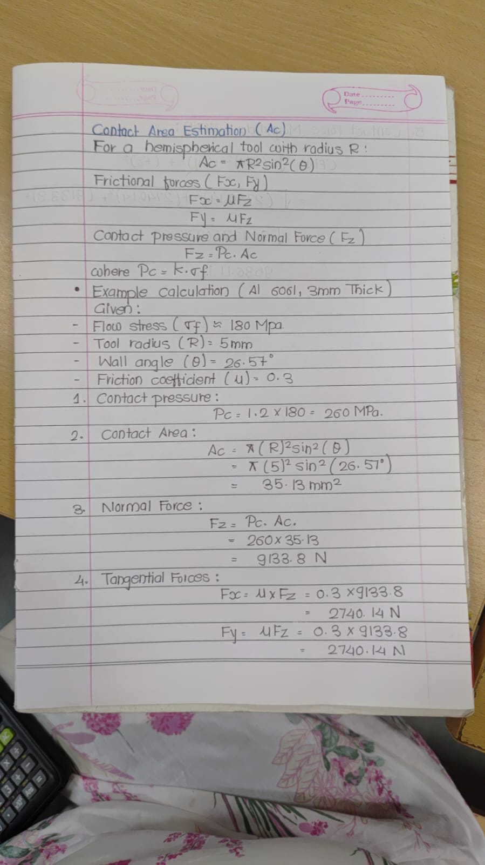
HAND CALCULATION
Fx Abaqus -2571.22N
Fx hand -2740.14 N
Percentage error – ((Fx hand – Fx Abaqus) /Fx Abaqus ) *100
((2740.14 - 2571.22) /2571.22 )* (100)
Therefore % error = 6.5%

Slide 18
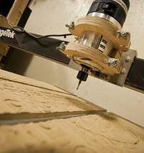
PROTOTYPE
.
Prototyping model : Before proceeding with fabrication, a trial version of the top and bottom plates was cut from MDF board using a wood router. This step allowed for a preliminary fitment check on the machine bed, ensuring that any necessary adjustments could be made before final manufacturing.
Same fixture designed on SolidWorks was used for manufacturing of base plate & top plate .
Exported the CAD design from SolidWorks and generated a G-code using ShopBot software and machined the base plate and top plate of the fixture prototype.
Checked the accuracy of MDF plates on the bed of 5-axis VMC machine in order to manufacture fixture plates from Mild steel
This Photo by Unknown Author is licensed under CC BY-SA-NC

Slide 19
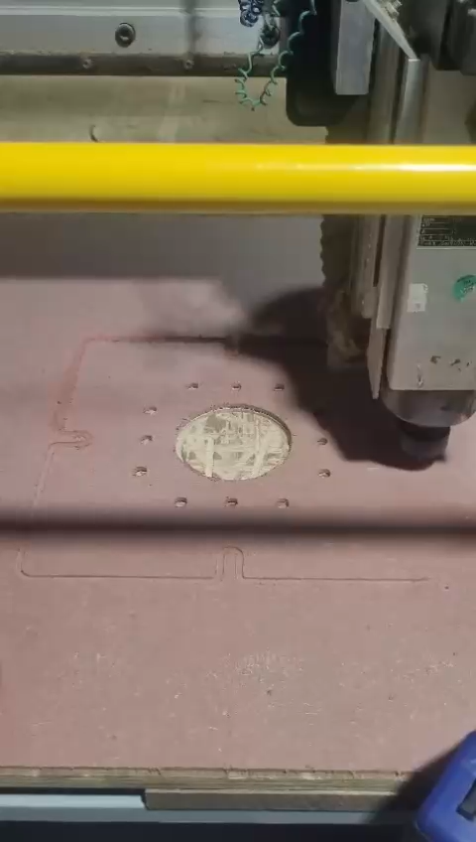
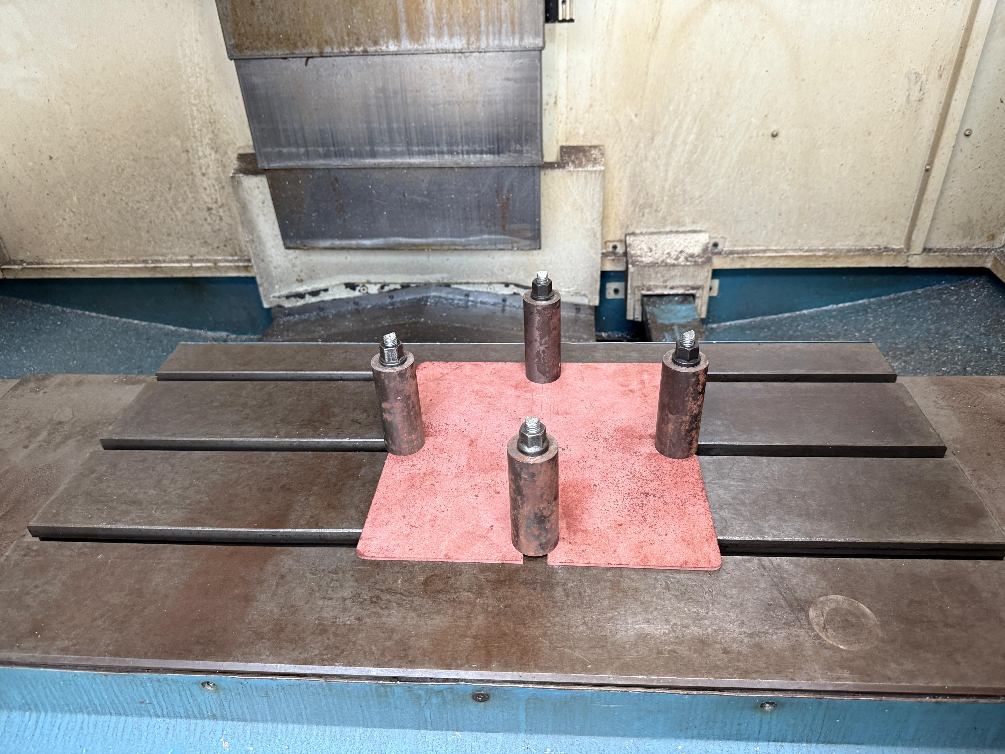
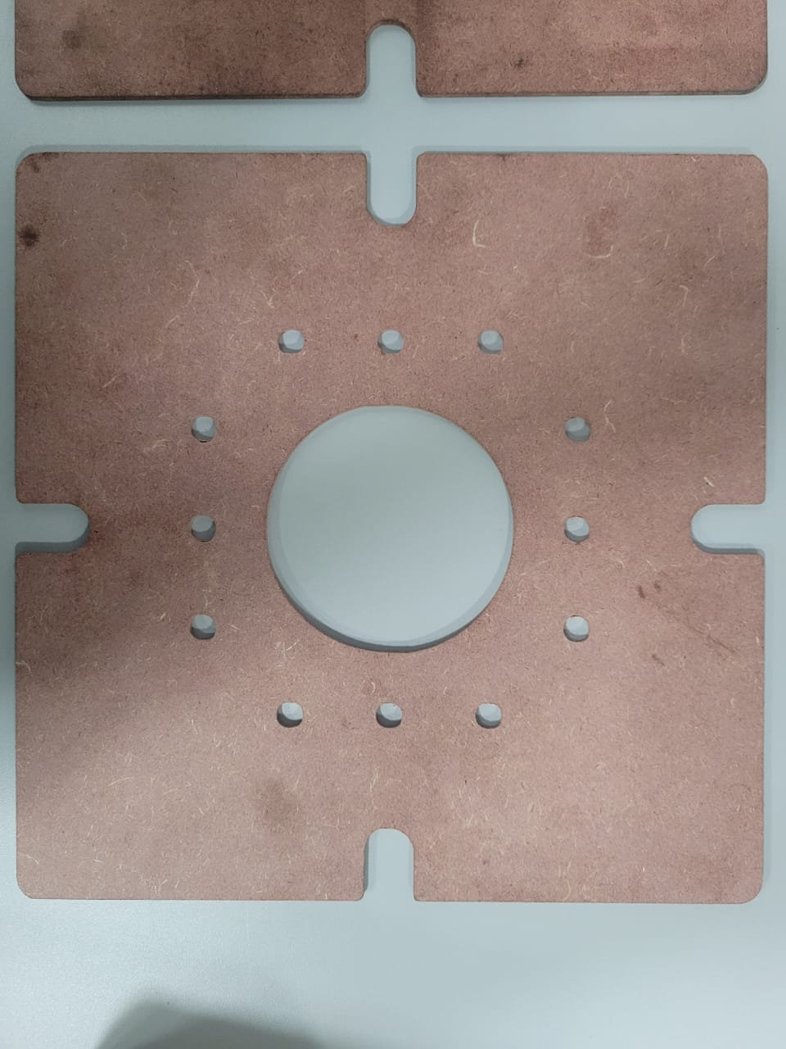
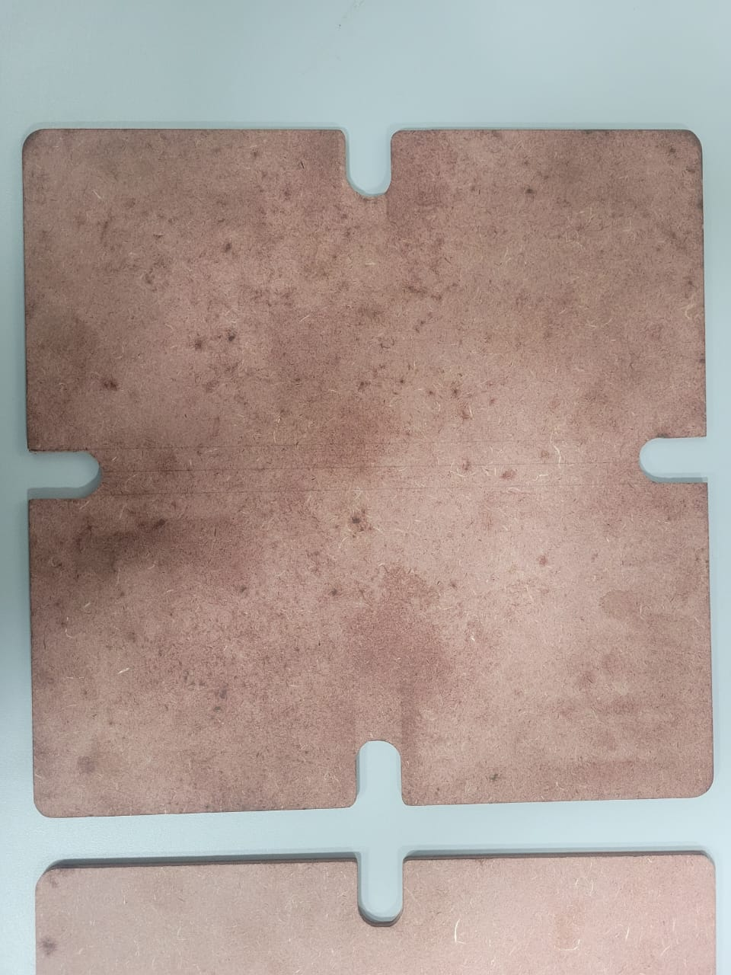
PROTOTYPE MODEL

Slide 20
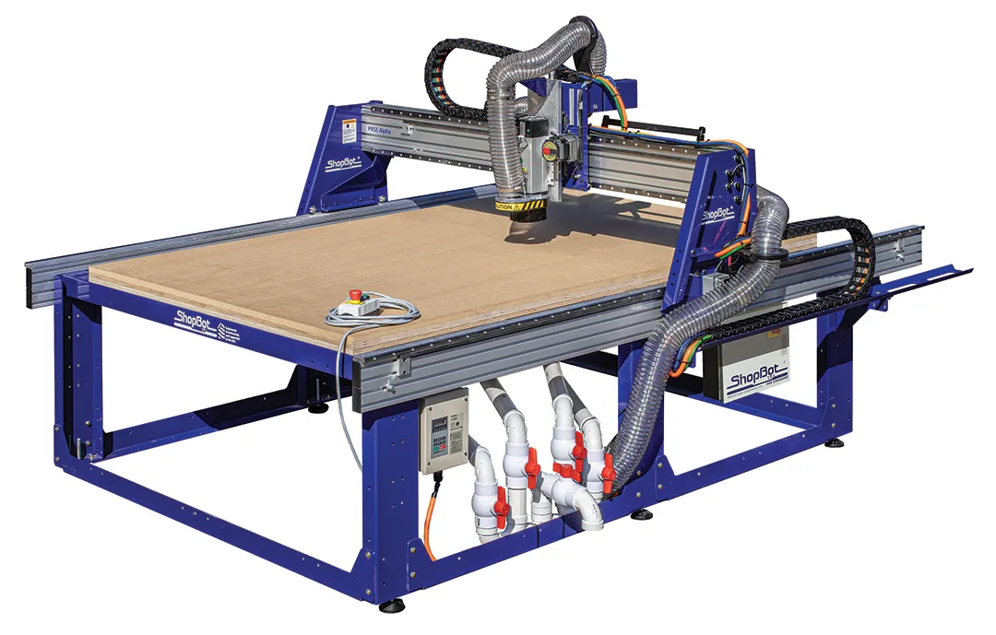
ShopBot PRS5 Standard CNC
XY Move Speed –MAX 9144mm/min
Z MOVE Speed –MAX3048 mm/min
Linear Cutting Force-60 in/min
Software used – PartWorks
MACHINING PARAMETER
Tool - end mill
Tool diameter – 6mm
Sheet thickness – 5mm
Spindle rpm -2000rpm

Slide 21
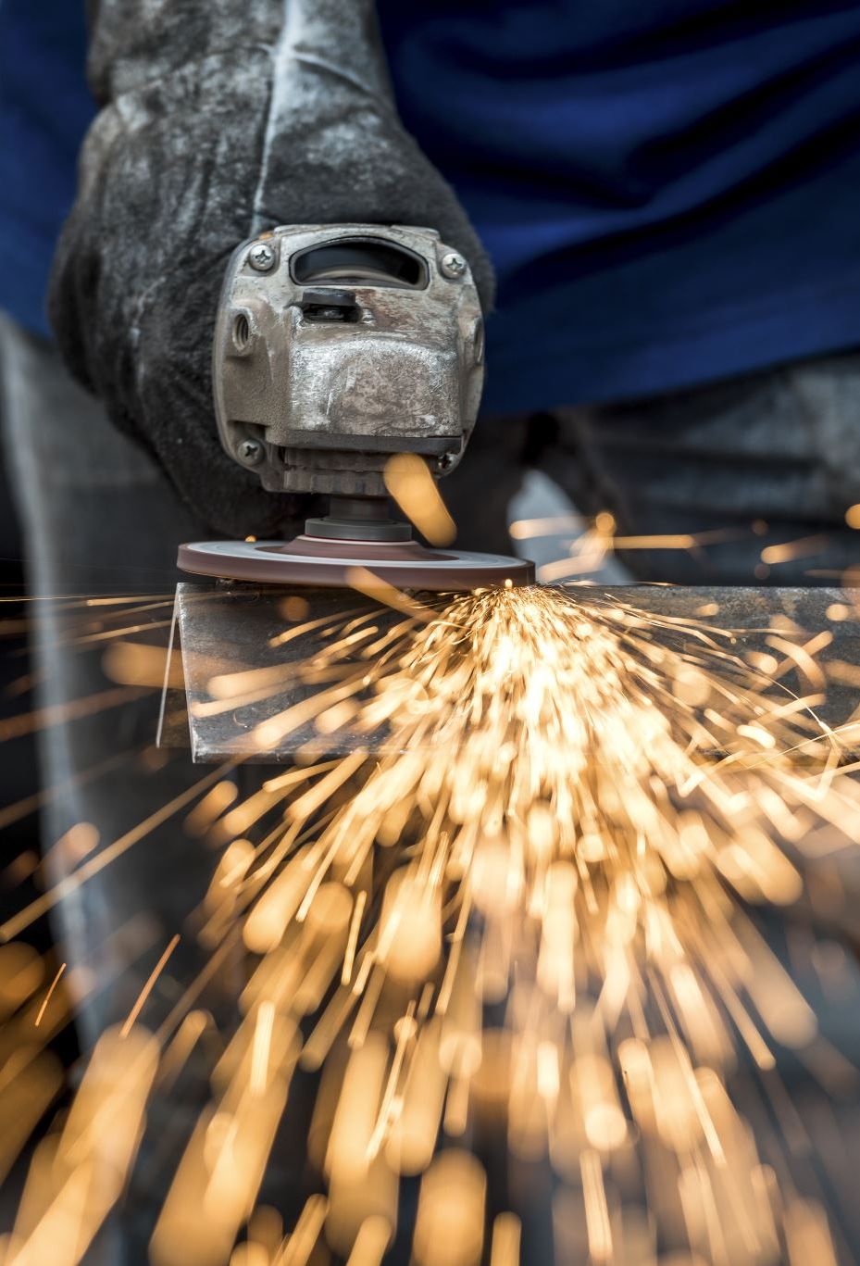
MANUFACTURING OPERATIONS
Base plate , Top plate & Clamping Plate : Laser cutting of 10 mm Mild steel (MS) .
Surface grinding was employed to precisely machine the top plate and base plate, ensuring perfect flatness and alignment with the machine bed, thereby enhancing the overall accuracy and stability of the setup.
Tool :- Grinding the tip of the tool to ensure a proper spherical curve shape of the tool

Slide 22
PURCHASE & QUOTATION
To ensure precision and quality in the manufacturing of fixture plates, we conducted a thorough vendor selection process across the city. After evaluating various options based on cost, reliability, and expertise in laser cutting operations, we shortlisted three reputable vendors :
MS LASERS – Rs 1700 with GST & material
KAKDE LASERS – Rs 2000 with GST &material
PRAGATI LASERS – Rs 1800 with GST & material
INHOUSE COMPONENTS
SPACERS
NUT & BOLT
GUIDE ROD

Slide 23
TESTING (Planned work)
Machine Setup:
The frustum will be manufactured using the 5-axis VMC available in our department.
Initial Preparation:
Place the fixture securely on the machine table.
Mount the forming tool onto the collet.
Dry Run & Accuracy Check:
Perform a dry run to verify toolpath accuracy and system readiness.
Ensure the tool's positioning and movement are precise before forming.
Frustum Manufacturing:
Clamp the aluminum sheet onto the fixture.
Execute the Single Point Incremental Forming (SPIF) process to form the frustum shape.
Final Verification & Denture Plate Manufacturing:
Inspect the accuracy and quality of the formed frustum.
Once verified, proceed with manufacturing the denture plate using the SPIF process.

Slide 24
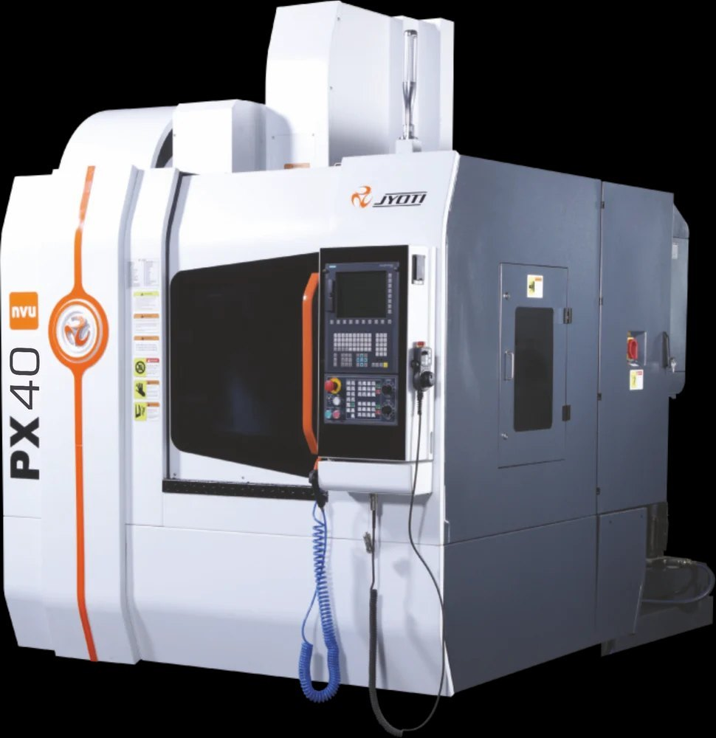
MACHINE SPECIFICATION
JYOTI PX 40
Table Size – 15*460 mm
T slot Dimensions – 3*14*125mm
X-axis travel-760mm
Y-axis travel -510mm
Z-axis travel-510mm
Cutting feed -10mm
No. of tools-20

Slide 25
REFERENCE :-
Jeswiet, J., & Hagan, E. (2004). Forming parameters for incremental forming of aluminum sheet. Proc. IMechE Part B: J. Eng. Manuf., 218(11), 1417–1421.
Duflou, J. R., et al. (2008). Process window enhancement for SPIF through toolpath adaptation. CIRP Annals, 57(1), 253–256.
Hussain, G., Gao, L., & Hayat, N. (2009). Forming parameters and their effect on forming forces in SPIF of aluminum sheets. Materials & Design, 30(4), 1220–1227.
Silva, M. B., et al. (2008). Single point incremental forming and formability failures. Journal of Strain Analysis, 46(7), 484–499.
Behera, A. K., et al. (2013). Tool–sheet interaction in SPIF under different friction conditions. Int. J. Material Forming, 6(4), 487–500.
Behera, A. K., et al. (2017). SPIF: Progress and trends (2005–2015). J. Manufacturing Processes, 27, 37–62.
Characterisation of geometrical and physical properties of a stainless steel denture framework manufactured by single-point incremental forming

